Slide 1

WEB TECHNOLOGIES
Introduction to WWW,
Web Protocols and URLs
Prof.Vinay Joshi and Prof.Pavithra S
Department of Computer Science and Engineering

Slide 2
Introduction to WWW, Web Protocols and URLs
WWW
WWW stands for World Wide Web. A technical definition of the World Wide Web is − All the resources and users on the Internet that are using the Hypertext Transfer Protocol (HTTP).
In simple terms, The World Wide Web is a way of exchanging information between computers on the Internet, tying them together into a vast collection of interactive multimedia resources.

Slide 3
Introduction to WWW, Web Protocols and URLs
Common Terms
Internet vs. Web
Web Browsers
URL
Web Server
DNS
HTTP Protocol
HTTPS

Slide 4
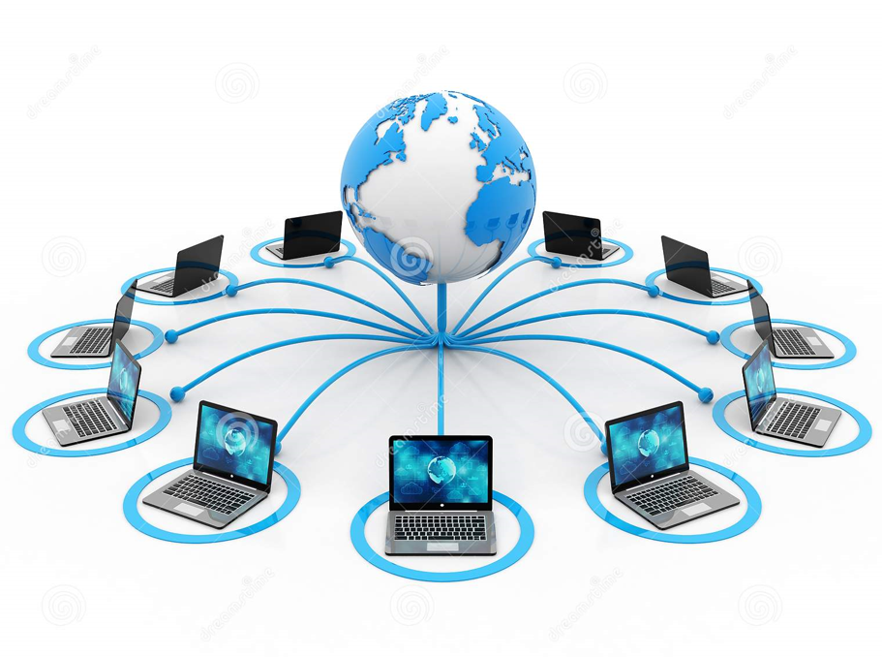
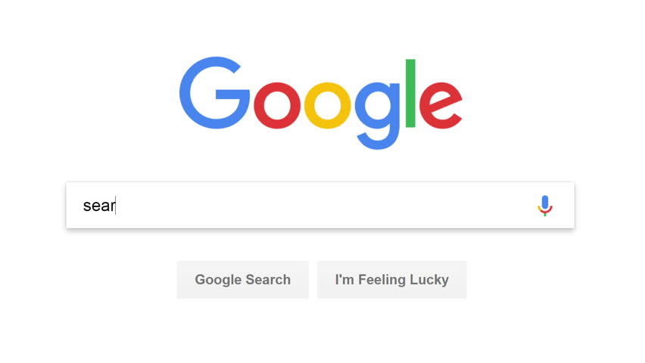
Introduction to WWW, Web Protocols and URLs
Internet vs. WWW
Notes:
The Internet is a global network of interconnected computers and servers that spans the entire globe. It is a massive infrastructure that allows various devices and networks to communicate with each other, enabling data exchange, communication, and information sharing. The Internet operates using a set of protocols, such as TCP/IP (Transmission Control Protocol/Internet Protocol), which govern the way data is transmitted and received between devices.
The World Wide Web, commonly known as the Web, is a subset of the Internet. It is a system of interconnected hypertext documents and resources that are accessed through the Internet using web browsers. The Web was invented by Sir Tim Berners-Lee in 1989 as a means to share and access information more efficiently.
the Internet is the underlying infrastructure, a vast global network of interconnected devices, while the World Wide Web is a specific application that runs on top of the Internet, allowing users to access and navigate web pages through hyperlinks and web browsers. The Web is just one of many services that operate on the Internet. Other services, like email, online gaming, and video conferencing, also rely on the Internet to function.

Slide 5
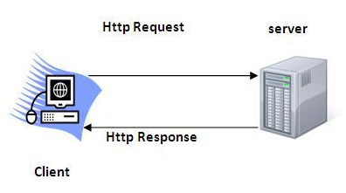
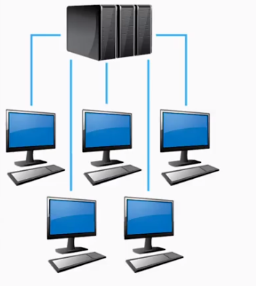
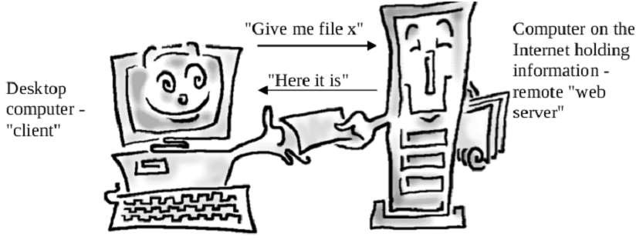
Introduction to WWW, Web Protocols and URLs
How does WWW work?
1. Client/Server Architecture
2. Request/Response Pattern

Slide 6
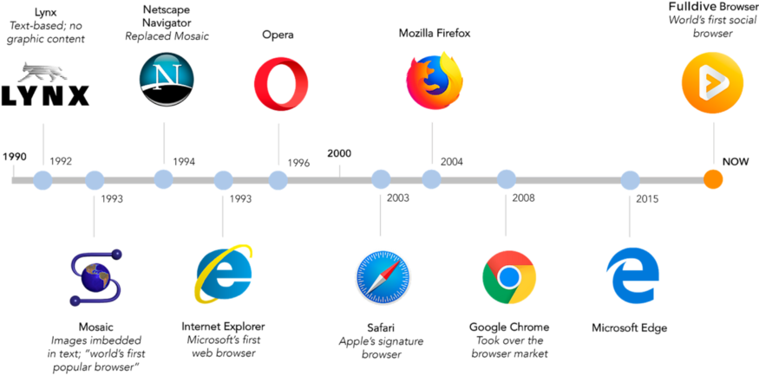

Introduction to WWW, Web Protocols and URLs
History of Web Browsers
2020
Microsoft Edge Based on chromium

Slide 7
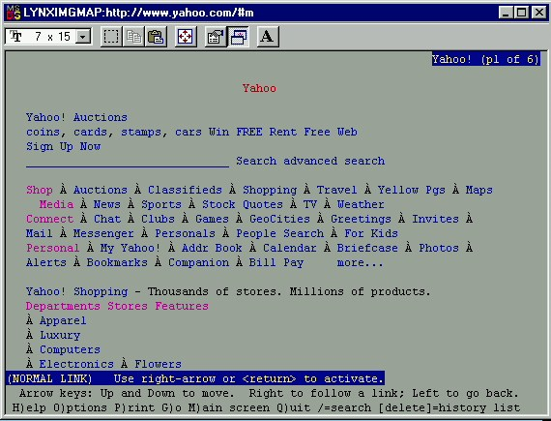
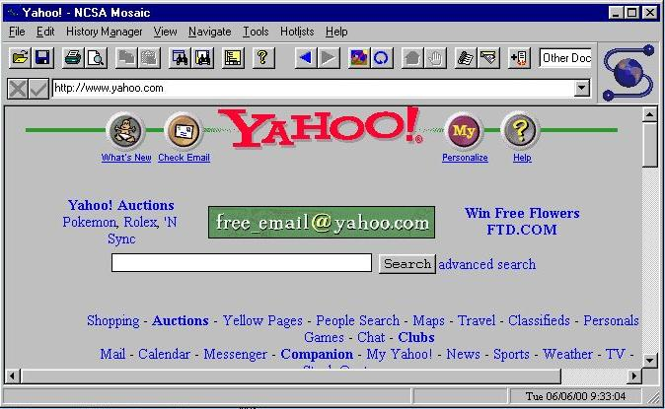
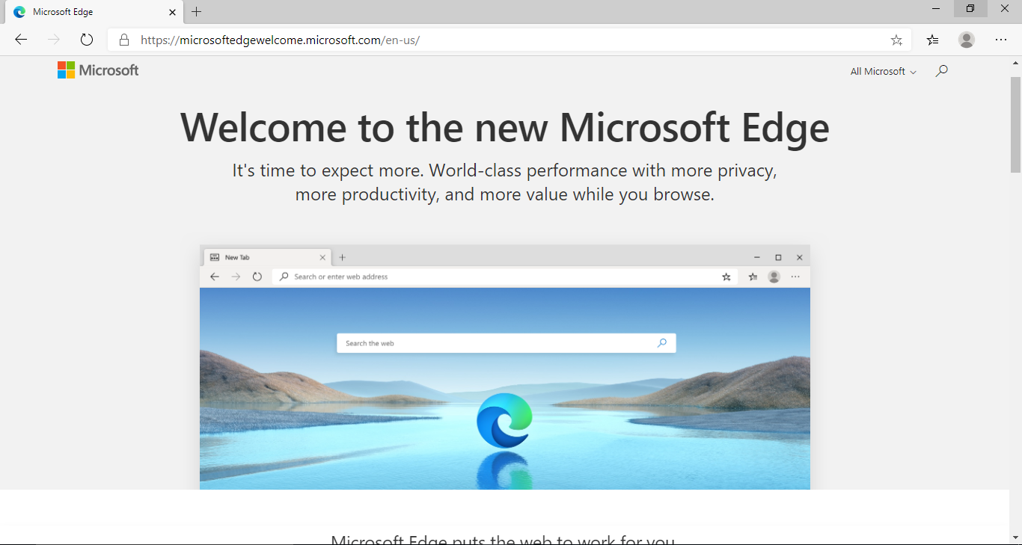
Introduction to WWW, Web Protocols and URLs
Browser Evolution
Lynx – A text based browser
Mosaic – the first graphical browser

Slide 8
Introduction to WWW, Web Protocols and URLs
URLs
URL stands for Uniform Resource Locator
General form:
scheme:object-address
For the http protocol, the object-address is:
fully qualified domain name/doc path
Example:
https://www.amazon.com/international-sales-offers.html
Notes:
Uniform Resource Locators (URLs): Each resource on the Web is identified by a unique address called a URL. URLs help users locate and access specific web pages or resources.
URL stands for "Uniform Resource Locator," and URI stands for "Uniform Resource Identifier." While these terms are often used interchangeably, there is a subtle difference between them:
URI (Uniform Resource Identifier): A URI is a broader term that encompasses both URLs and URNs (Uniform Resource Names). URIs are used to identify resources on the internet or any other system, and they provide a way to uniquely identify a resource. URIs consist of a string of characters that serve as a reference to a resource.
URL (Uniform Resource Locator): A URL is a specific type of URI that not only identifies a resource's location but also provides a means to locate and retrieve that resource. In other words, a URL includes information about how to access the resource, such as the protocol (e.g., HTTP, HTTPS), the domain name (or IP address), the port number, and the path to the resource.
Here's an example to illustrate the difference between a URL and a URI:
URI: urn:isbn:0451450523 This is a URI in the form of a URN (Uniform Resource Name). It uniquely identifies a resource as an ISBN (International Standard Book Number) and provides information about the format of the identifier.
URL: https://www.example.com/images/pic.jpg This is a URL that points to an image file. It includes the protocol (HTTP), the domain name (www.example.com), the path to the resource (/images/pic.jpg), and potentially additional components like query parameters or fragments.
In summary, all URLs are URIs, but not all URIs are URLs. URIs serve as a general concept for identifying resources, while URLs are a specific subset of URIs that provide information on how to access those resources.
URI (Uniform Resource Identifier): A URI is a string of characters that identifies a resource, whether it's a web page, a file, or any other item that can be accessed over a network. URIs are further divided into two subcategories: URLs and URNs.
URL (Uniform Resource Locator): A URL is a specific type of URI that not only identifies a resource but also provides a means to locate the resource by describing its address. URLs include information about the protocol to be used (e.g., HTTP, HTTPS, FTP), the domain or IP address, the port number (if necessary), the path to the resource, and potentially query parameters or fragments.
Here's a brief comparison:
URI:
A broader concept that includes both URLs and URNs.
Focuses on identifying a resource.
May or may not include information about how to access the resource.
Examples of URIs: isbn:0451450523 (URN), mailto:john@example.com (URL with 'mailto' scheme), tel:+123456789 (URL with 'tel' scheme).
URL:
A specific subset of URIs.
Not only identifies a resource but also includes information to locate and retrieve it.
Contains details like the protocol, domain, port, path, query parameters, and fragments.
Examples of URLs: https://www.example.com/page.html, ftp://ftp.example.com/file.zip, file:///path/to/local/file.txt.
In summary, while all URLs are URIs, not all URIs are URLs. URIs encompass a broader range of resource identifiers, including URLs for resource location and URNs for resource naming. URLs provide additional information beyond identification, detailing how to access the resource.
URL:
A specific subset of URIs.
Not only identifies a resource but also includes information to locate and retrieve it.
Contains details like the protocol, domain, port, path, query parameters, and fragments.
Examples of URLs: https://www.example.com/page.html, ftp://ftp.example.com/file.zip, file:///path/to/local/file.txt.
In summary, while all URLs are URIs, not all URIs are URLs. URIs encompass a broader range of resource identifiers, including URLs for resource location and URNs for resource naming. URLs provide additional information beyond identification, detailing how to access the resource.

Slide 9
Introduction to WWW, Web Protocols and URLs
Web Servers
General Web Server Characteristics
Web servers have two main directories:
Document root (servable documents)
Server root (server system software)
Document root is accessed indirectly by clients
Its actual location is set by the server configuration file
Requests are mapped to the actual location
Popular Examples
Apache
IIS

Slide 10
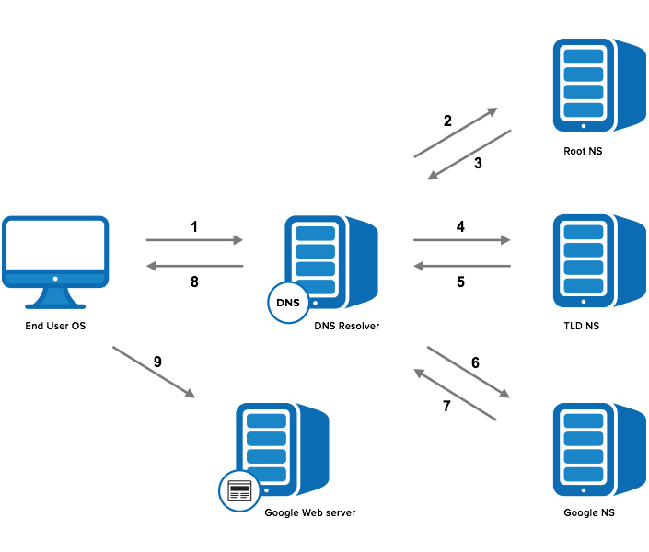
Introduction to WWW, Web Protocols and URLs
Domain Name Service
Step 1: OS Recursive Query to DNS Resolver
Step 2: DNS Resolver Iterative Query to the Root Server
Step 3: Root Server Response
Step 4: DNS Resolver Iterative Query to the TLD Server
Step 5: TLD Server Response
Step 6: DNS Resolver Iterative Query to the Google.com NS
Step 7: Google.com NS Response
Step 8: DNS Resolver Response to OS
Step 9: Browser Starts TCP Handshake

Slide 11
Introduction to WWW, Web Protocols and URLs
How to get your own website?
Steps:
1. Choose a domain name
2. Register a domain and sign up with web hosting
3. Set up a website using WordPress/Name cheap/Go Daddy (through web host)
4. Customize your website design and structure
5. Add pages and content to your website

Slide 12
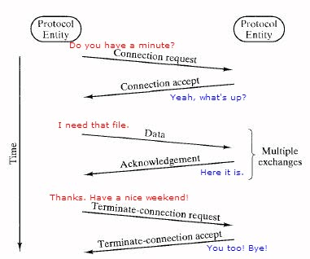
Introduction to Web Protocols and HTTP
What is a Protocol?
A protocol is a set of rules and guidelines for communicating data.
Different applications use different protocols
The web, in particular, uses multiple protocols to communicate.
The most important and visible protocols are HTTP and HTTPS.

Slide 13


Introduction to Web Protocols and HTTP
HTTP Overview
HTTP: HyperText Transfer Protocol
Application Protocol used by the Web
Client/Server model
Client: browser that requests, receives, and “displays” Web Objects
Server: Web server sends Web Objects (using HTTP protocol) in response to requests
server
running
Apache Web
server
HTTP request
PC running
Firefox browser
HTTP response
HTTP request
HTTP response
iphone running
Safari browser

Slide 14
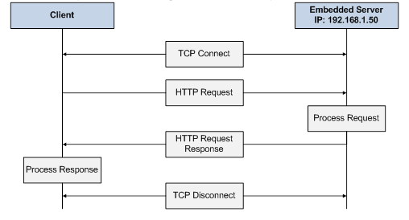
Introduction to Web Protocols and HTTP
HTTP Overview…(cntd.)
uses TCP:
client initiates TCP connection (creates socket) to server, port 80
server accepts TCP connection from client
HTTP messages (application-layer protocol messages) exchanged between browser (HTTP client) and Web server (HTTP server)
TCP connection closed
HTTP is “stateless”
server maintains no information about past client requests

Slide 15
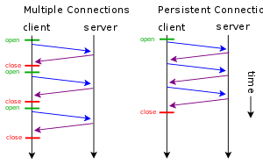
Introduction to Web Protocols and HTTP
HTTP Connections
non-persistent HTTP
at most one object sent over TCP connection
connection is then closed
downloading multiple objects required multiple connections
persistent HTTP
multiple objects can be sent over single TCP connection between client, server

Slide 16
Introduction to Web Protocols and HTTP
HTTP Requests
HTTP request is a request line, followed by zero or more request headers
Request line: <method> <uri> <version>
<version> is HTTP version of request
(HTTP/1.0 or HTTP/1.1)
<uri> is typically URL for proxies, URL suffix for servers.
<method> is either GET, POST, OPTIONS, HEAD, PUT, DELETE, or TRACE.
Request Header
Blank line (CRLF)
Message Body
GET /test.html HTTP/1.1
Accept: */*
Accept-Language: en-us
Accept-Encoding: gzip, deflate
User-Agent: Mozilla/4.0 (compatible; MSIE 4.01; Windows 98)
Host: euro.ecom.cmu.edu
Connection: Keep-Alive
CRLF (\r\n)

Slide 17
Introduction to Web Protocols and HTTP
HTTP Request Methods
HTTP methods:
GET: Retrieve static or dynamic content
POST: Send content to server through request body
OPTIONS: Get server or file attributes
HEAD: Fetches only header field without any response body
PUT: Write a file to the server
DELETE: Delete a file on the server

Slide 18
Introduction to Web Protocols and HTTP
HTTP Response
HTTP/1.1 200 OK
Date: Thu, 22 Jul 1999 04:02:15 GMT
Server: Apache/1.3.3 Ben-SSL/1.28 (Unix)
Last-Modified: Thu, 22 Jul 1999 03:33:21 GMT
ETag: "48bb2-4f-37969101"
Accept-Ranges: bytes
Content-Length: 79
Keep-Alive: timeout=15, max=100
Connection: Keep-Alive
Content-Type: text/html
CRLF
<html>
<head><title>Test page</title></head>
<body>
<h1>Test page</h1>
</html>
HTTP response is a response line followed by zero or more response headers.
Response line:
<version> <status code> <status msg>
<version> is HTTP version of the response.
<status code> is numeric status.
Response headers:
<header name>: <header data>
Provide additional information about response
Content-Type: MIME type of content in response body.
Content-Length: Length of content in response body.

Slide 19
Introduction to Web Protocols and HTTP
HTTP Response : Status Codes
Three-digit number; first digit specifies the general status
1 => Informational
2 => Success
3 => Redirection
4 => Client error
5 => Server error
<status msg> is corresponding English text.
200 OK => Request was handled without error
403 Forbidden => Client lacks permission to access file
404 Not found => Server couldn’t find the file.

Slide 20
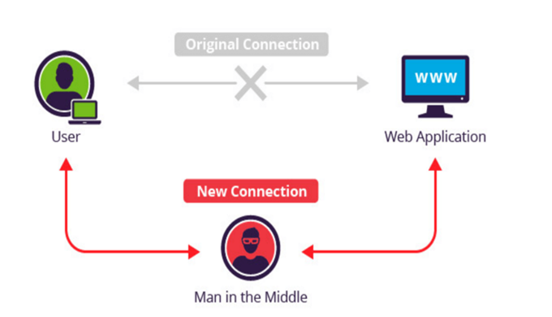
Introduction to Web Protocols and HTTP
HTTP Secure (HTTPS)
A common security attack
Need to encrypt data to save it from such attacks

Slide 21
THANK YOU
Prof.Vinay Joshi and Prof.Pavithra S
Department of Computer Science and Engineering
vinayj@pes.edu , pavithra.s@pes.edu
+91 80 2672 6622

